Slide 1
QR CODE

Slide 2








SOCIAL MEDIA Trend Analysis
ML Operations ∙ Sofie Pischl ∙ 17 Mai 2025

Slide 3
TABLE OF CONTENTS
01
02
03
04
05
06
The Vision
The Data
The Architecture
The Result
The Learning
FINAL REVIEW

Slide 4

01
The Vision

Slide 5
The Vision
Umfassende Social Media Trend Analyse
Welche Themen sind grade aktuell? Welche Themen werden kommen? Welche Themen verlieren oder gewinnen an Beduetung?

Slide 6

02
The Data

Slide 7





The Data

Slide 8

03
The Architecture

Slide 9









Die Architektur
scraper
preprocessing
exploration
prediction

Slide 10
preprocessing
exploration
prediction

Slide 11
preprocessing
exploration
prediction

Slide 12
04
The Result

Slide 13


123,123
Keep track of interactions with your posts

Slide 14
04
The Learnings

Slide 15

THANKS
Do you have any questions?
youremail@freepik.com
+91 620 421 838
yourwebsite.com

Slide 16




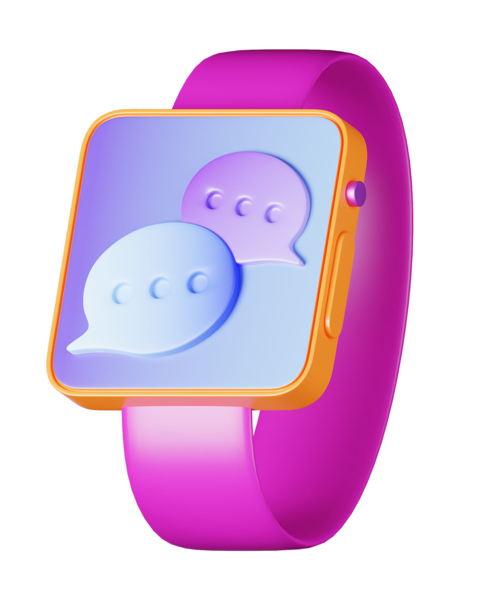



ALTERNATIVE RESOURCES
Here’s an assortment of alternative resources whose style fits that of this template:
ILLUSTRATIONS
Communication and social media icons I
Communication and social media icons II
Communication and social media icons III

Slide 17
Fonts & colors used
This presentation has been made using the following fonts:
Sora
(https://fonts.google.com/specimen/Sora)
Catamaran
(https://fonts.google.com/specimen/Catamaran)
#232252
#ffffff
#d1343a
#f8986f
#edaf4f
#90caf7
#2e6cdb
#9364eb
#e750ae

